Slide 1
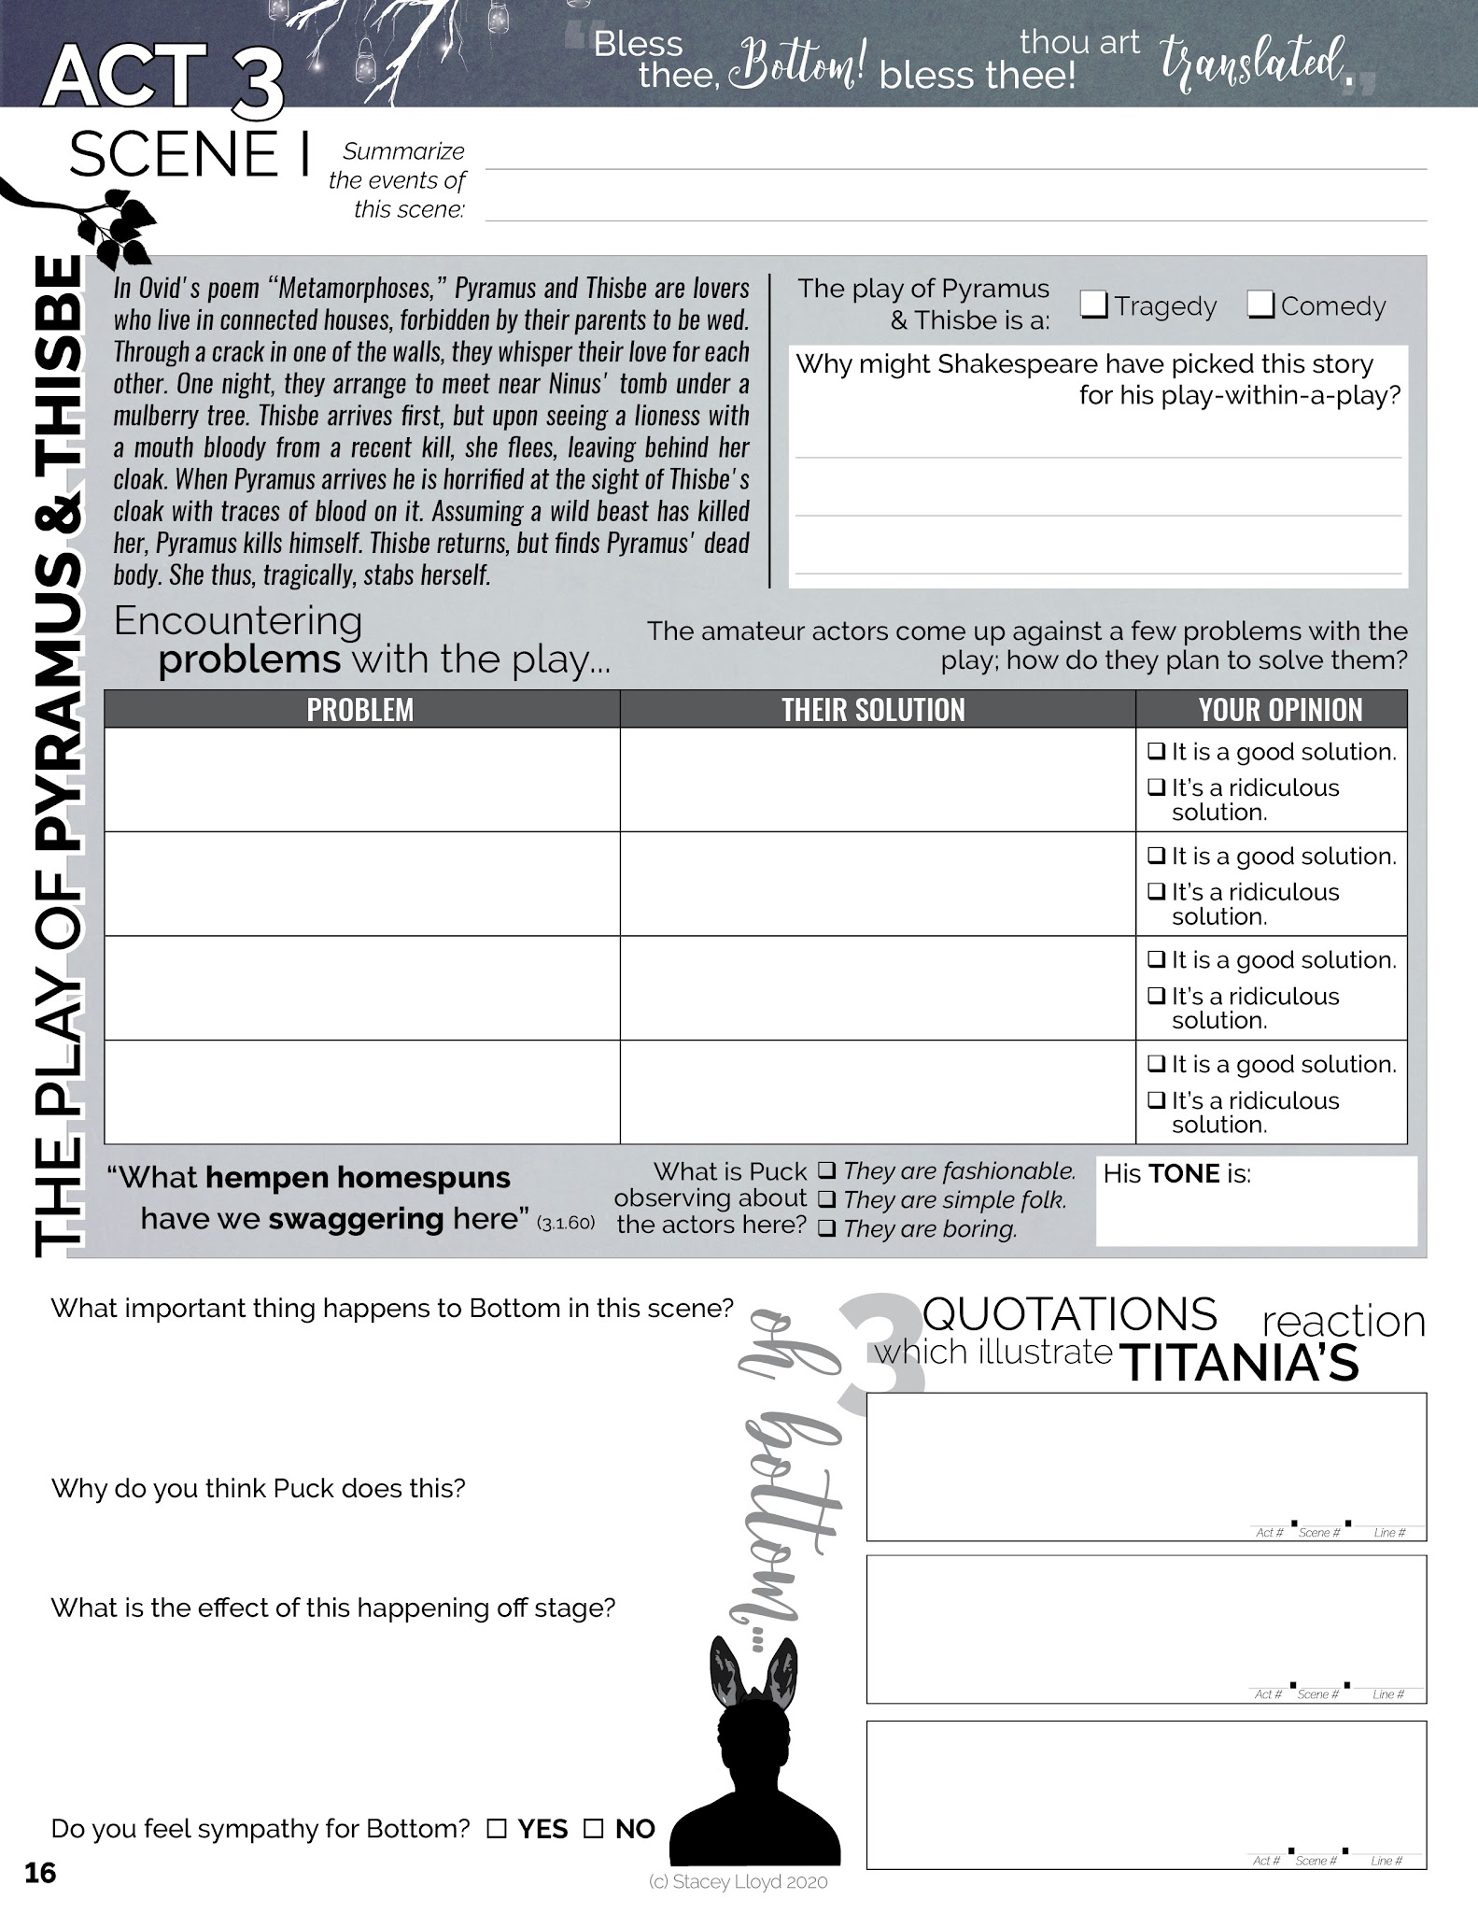

Slide 2
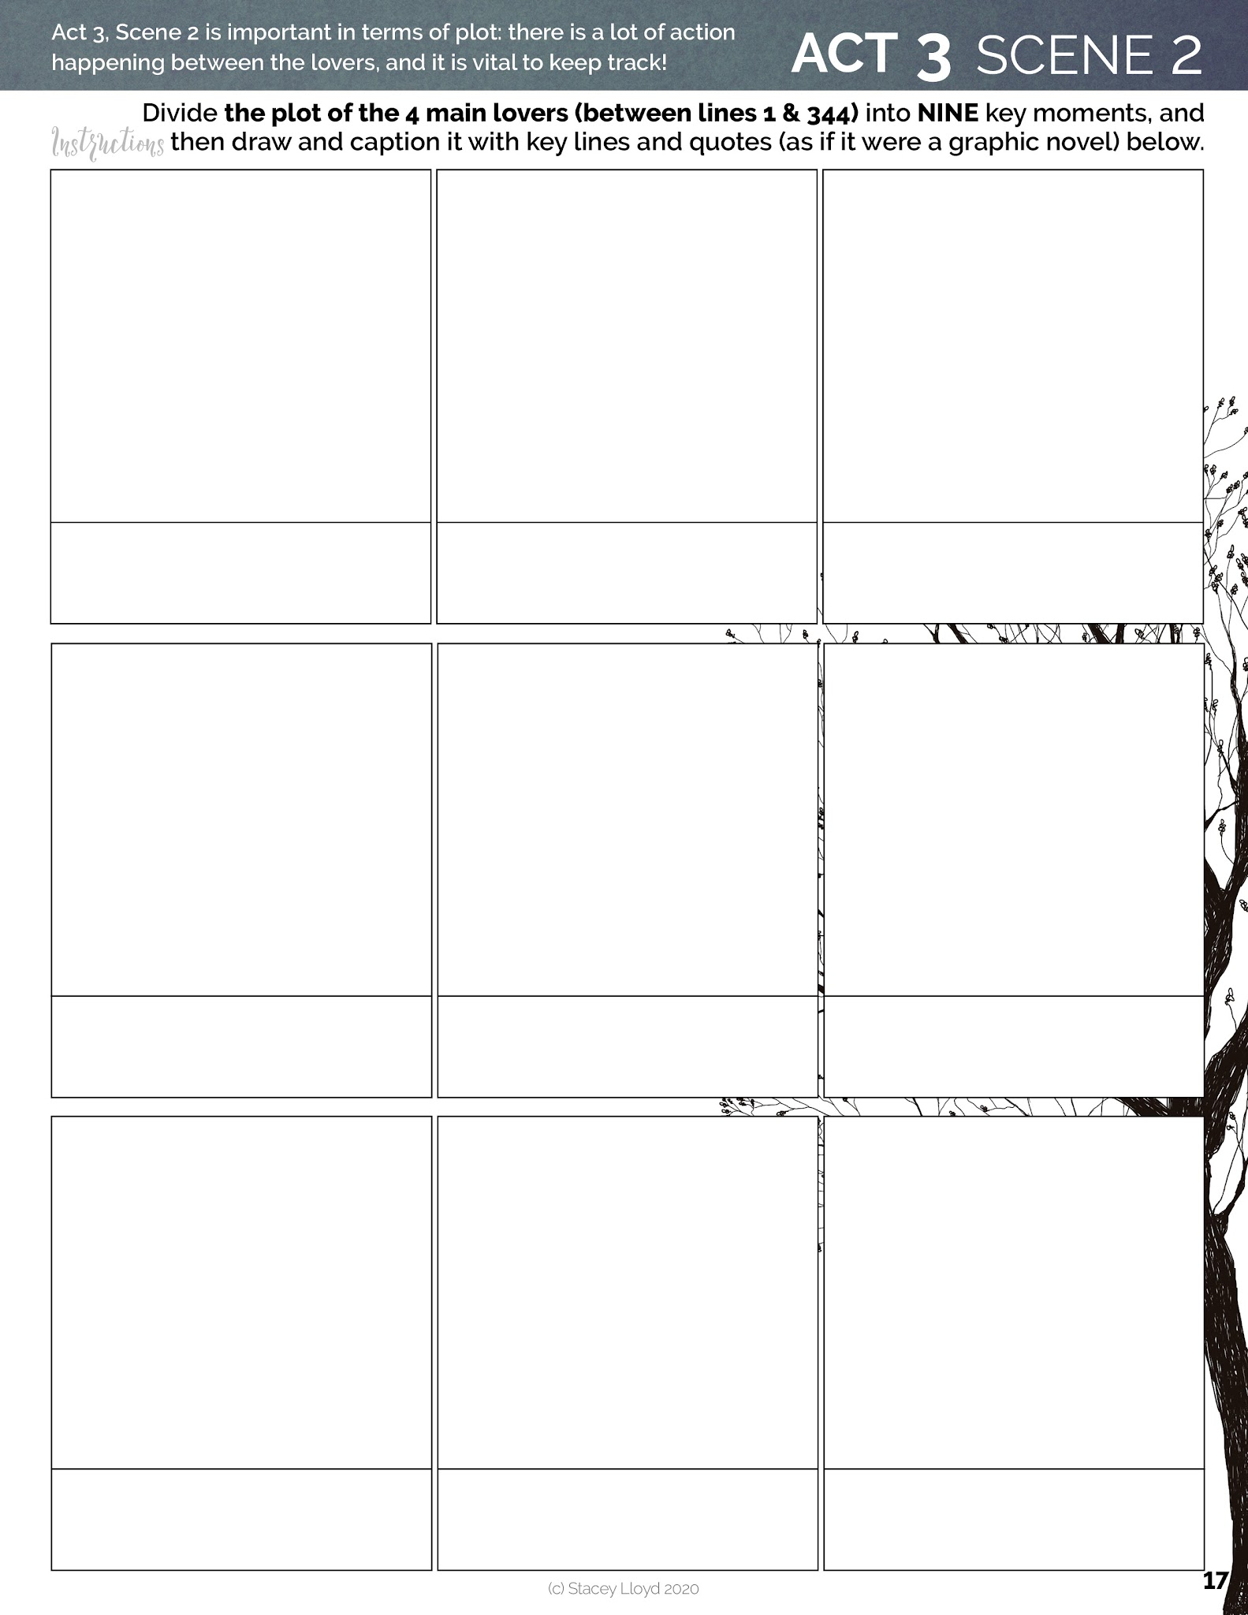
[Draw, or copy and paste images]

Slide 3
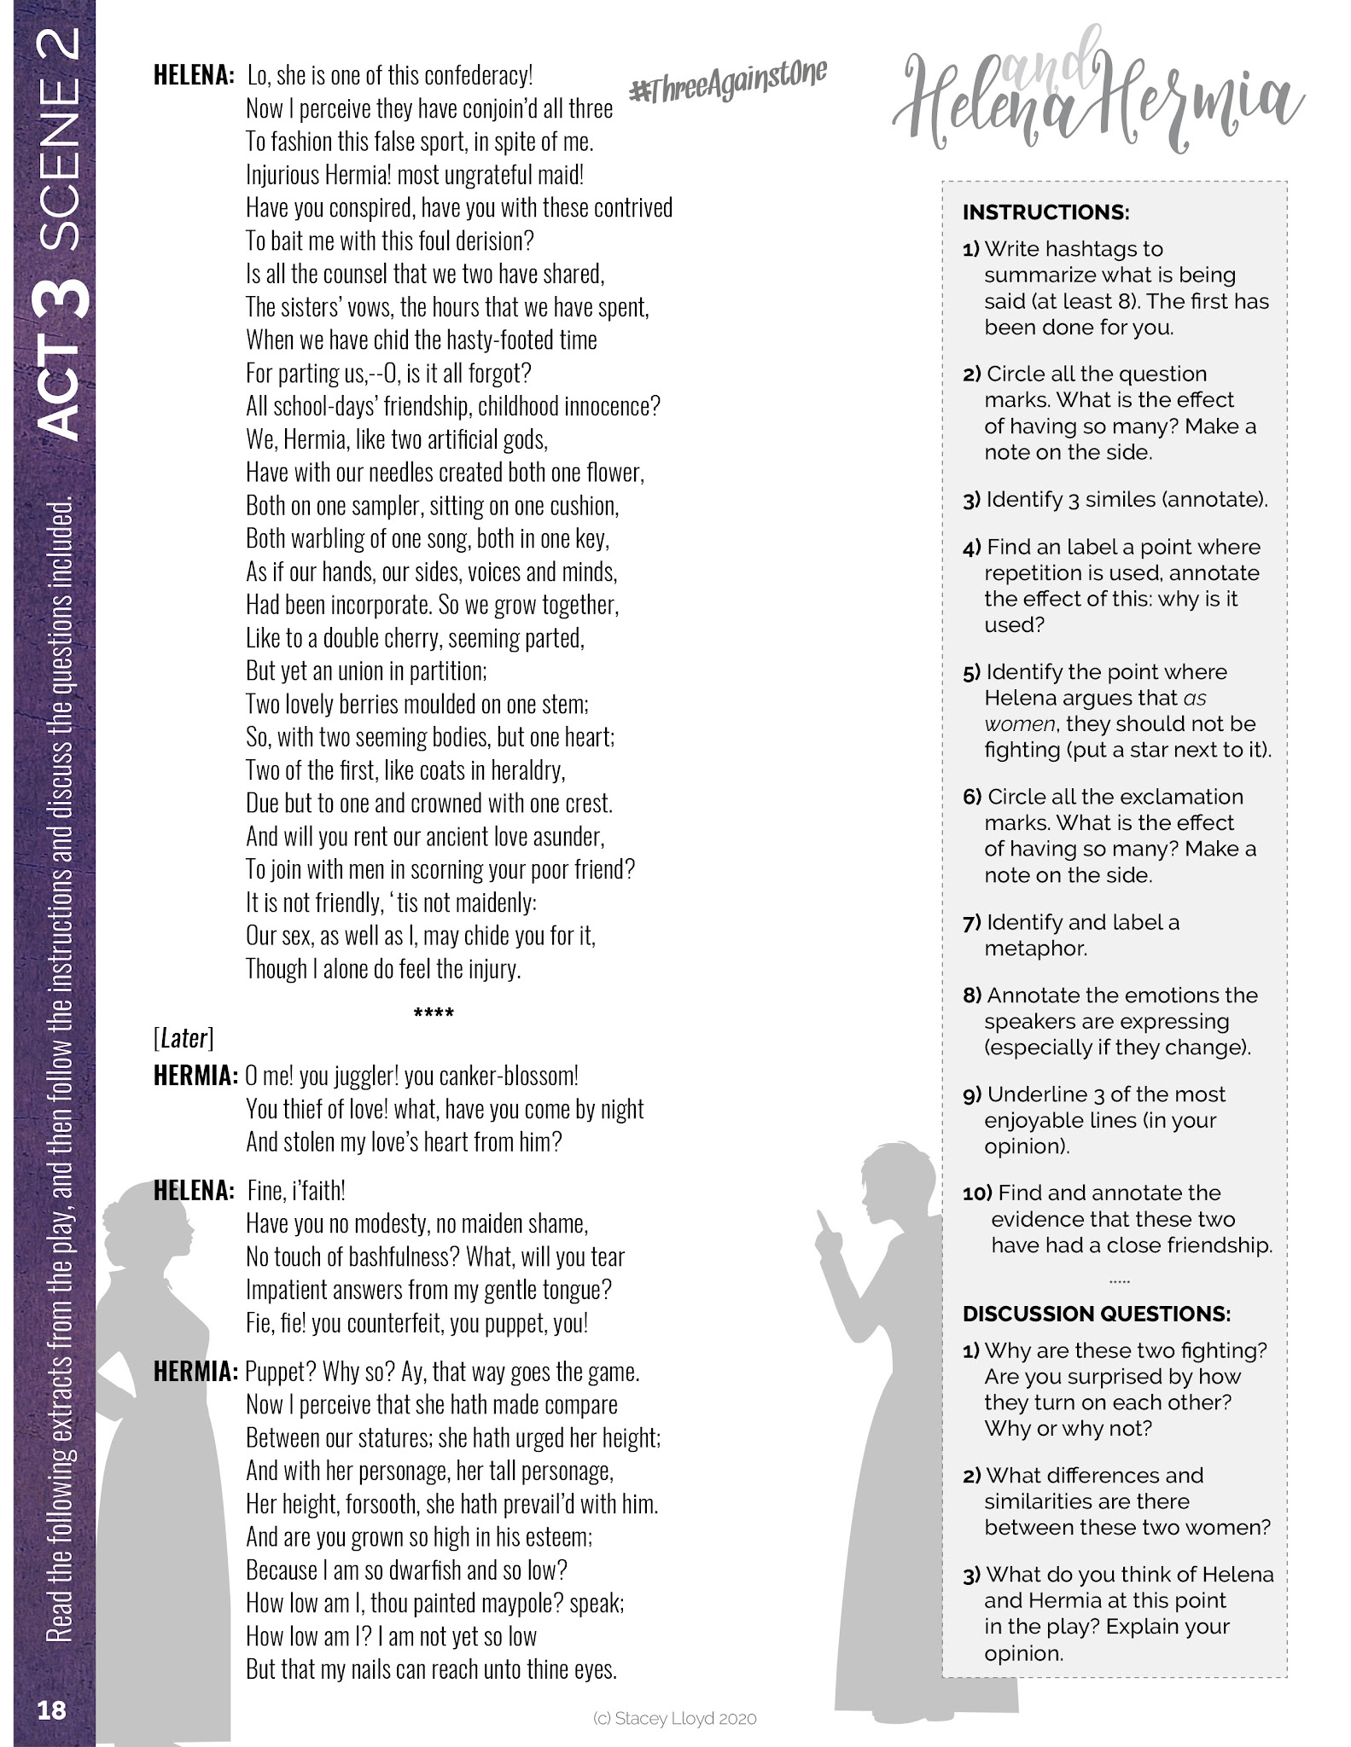
[Draw text boxes, use lines, etc.)

Slide 4
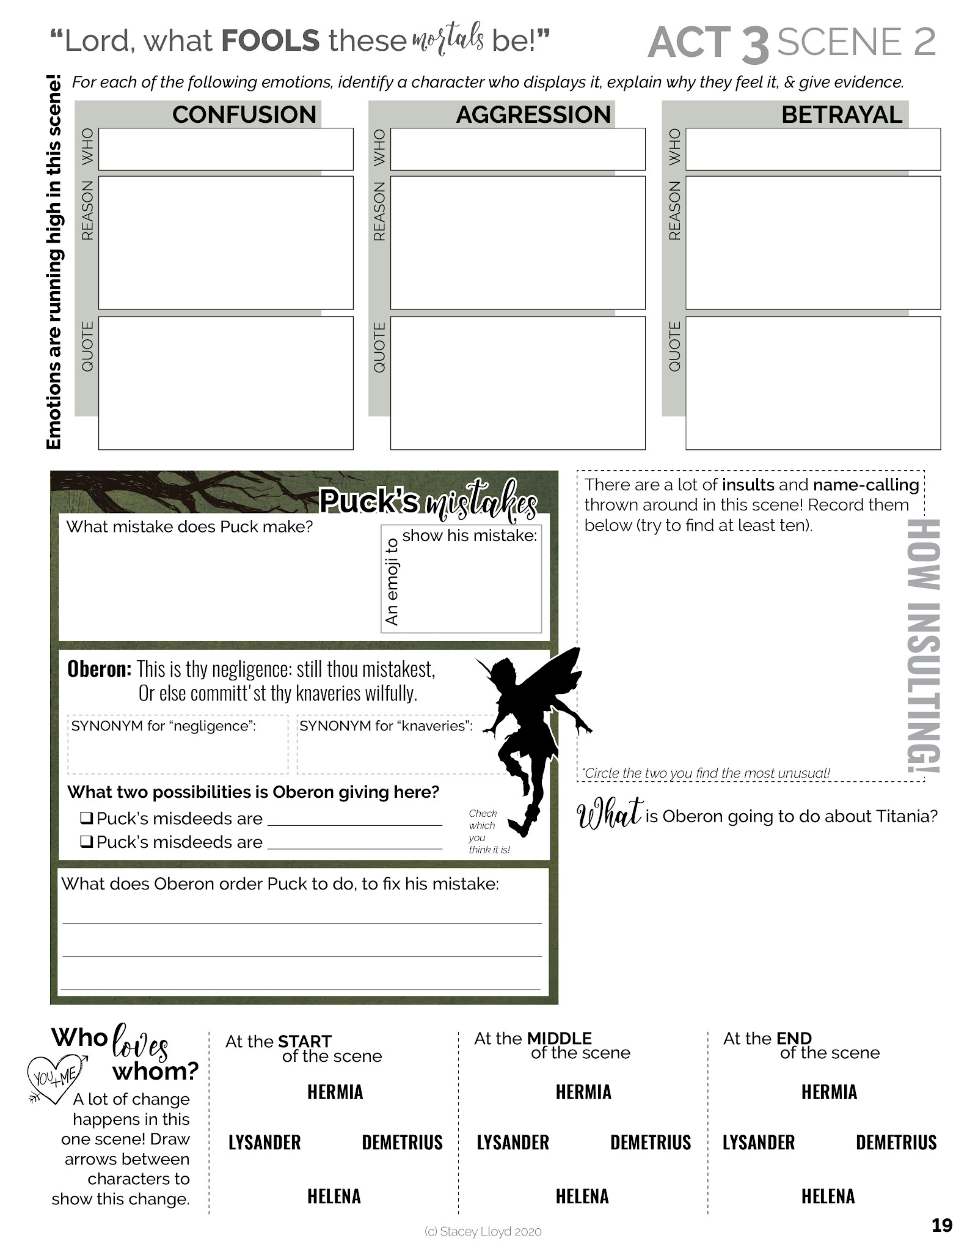

Slide 5
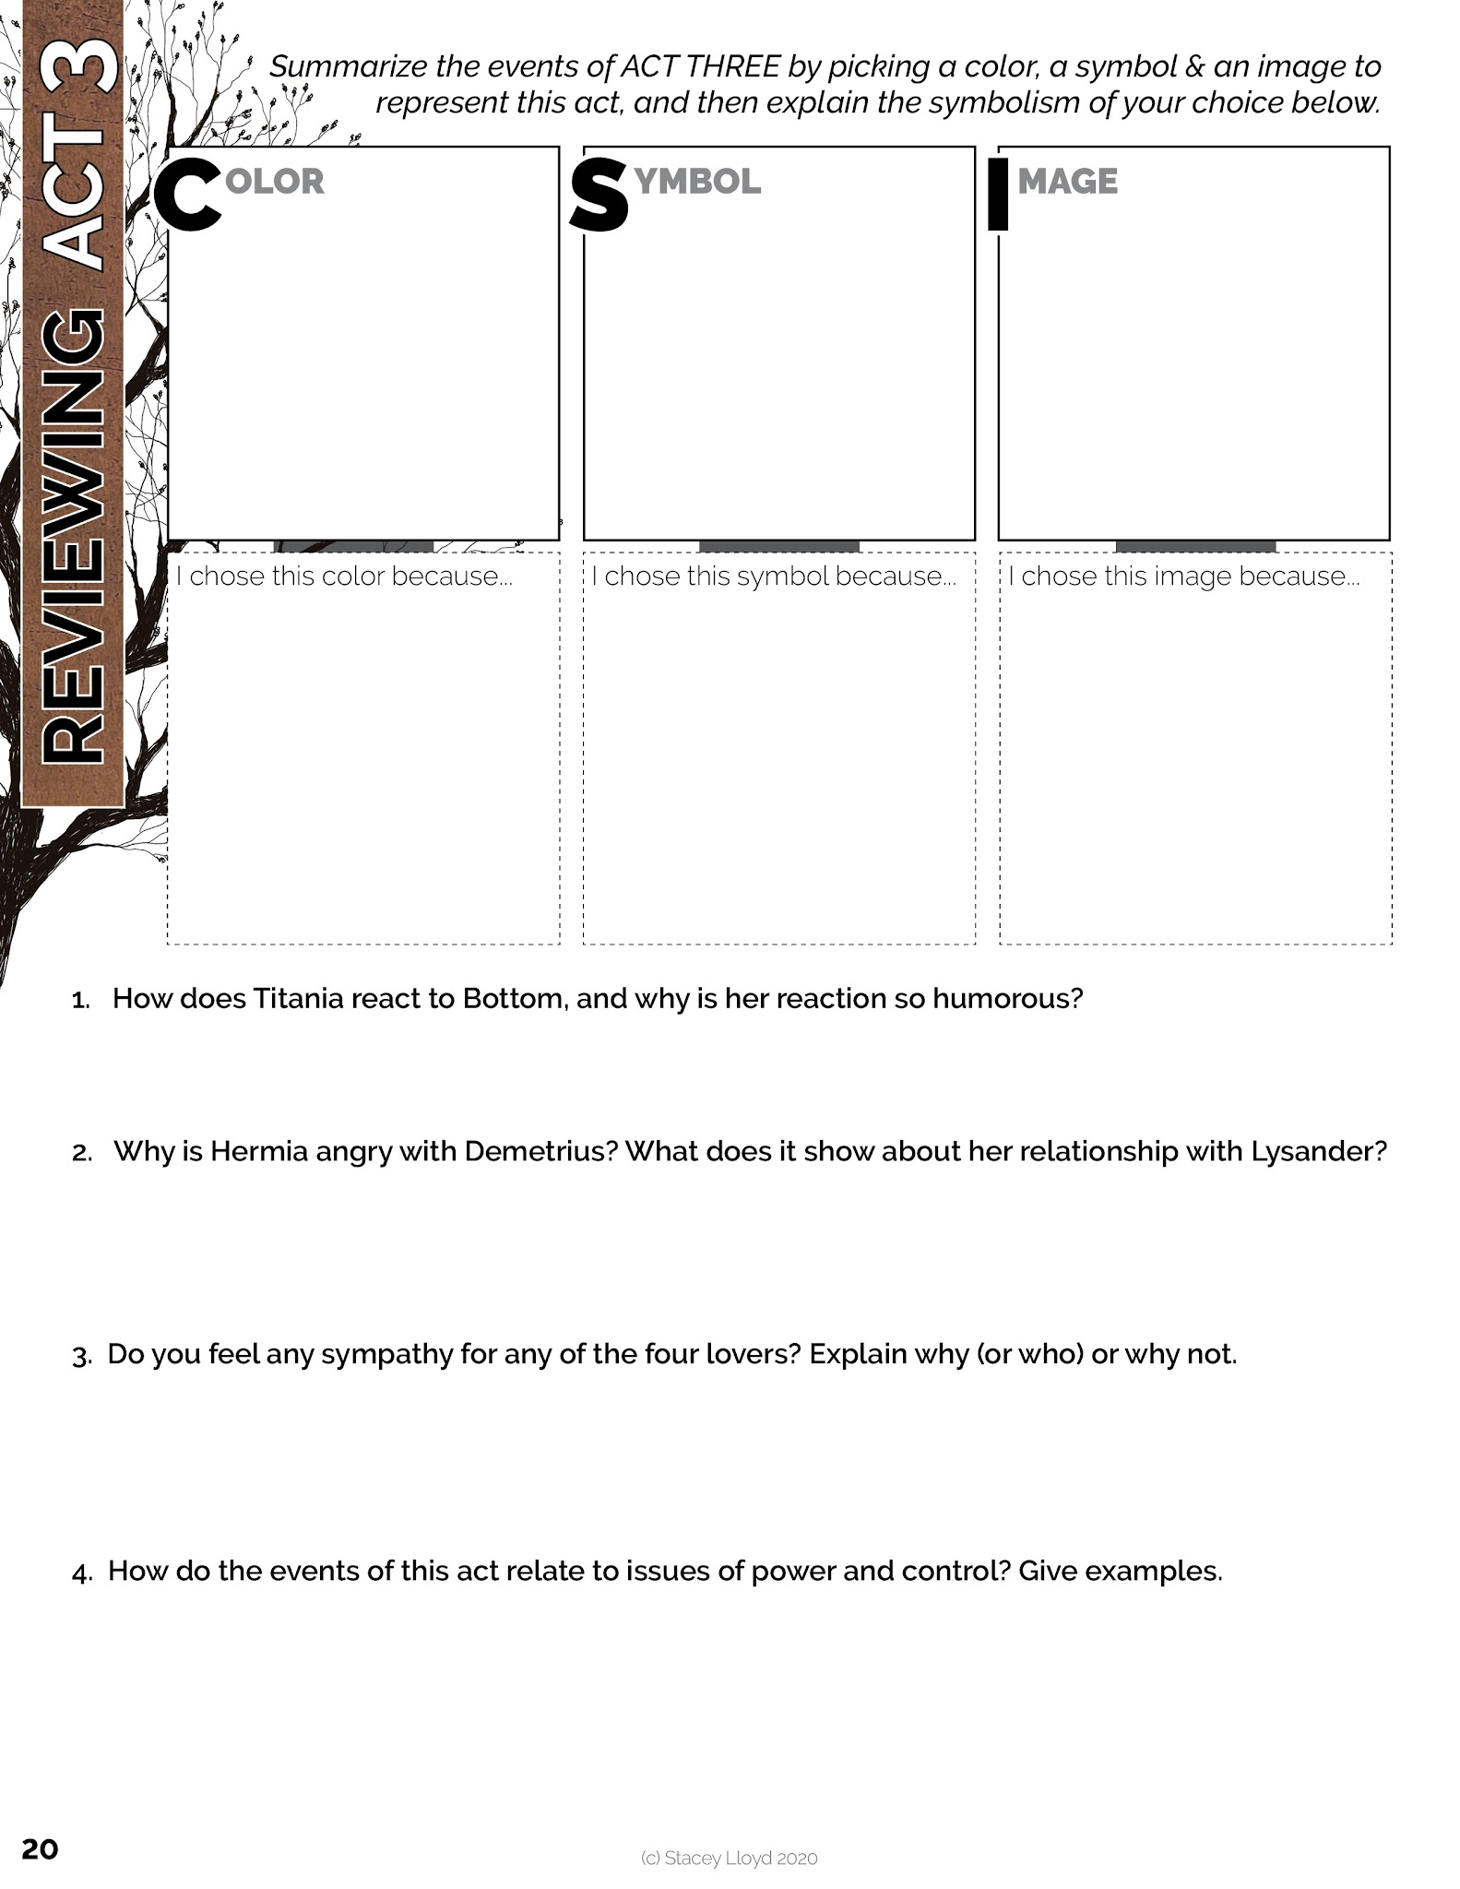
[Draw or copy and paste images)

Slide 6


Slide 7
